Slide 1

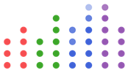
On Machine Learning and Programming Languages
Viral Shah
July 28, 2018
Vijay Ivaturi (UMB), Chris Rackauckas (UCI), Simon Byrne (Julia Computing), Mike Innes (Julia Computing), David Barber (UCL), Tim Besard (UGent),
James Bradbury (Salesforce Research), Valentin Churavy (MIT), Simon Danisch (MIT), Alan Edelman (MIT), Stefan Karpinski (Julia Computing),
Jon Malmaud (MIT), Jarrett Revels (MIT), Viral Shah (Julia Computing), Pontus Stenetorp (UCL) and Deniz Yuret (Koç University)

Slide 2

Are Deep Neural Nets ”Software 2.0”?

Slide 3
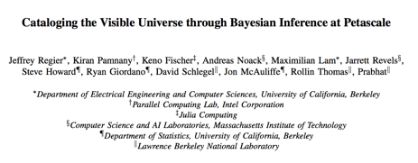
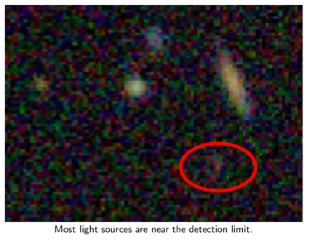




Julia ML at PetaScale to catalog the visible universe
650,000 cores. 1.3M threads. 60 TB of data.

Slide 4
Cori Phase II
Cori Phase II – 1.5 PetaFlop/s

Slide 5
Google TPU 3.0: 100 PetaFLOPS per Pod
Google TPU 3.0: 100 PetaFlop/s per Pod

Slide 6
(Spoiler: only Swift and Julia makes the cut) https://github.com/tensorflow/swift/blob/master/docs/WhySwiftForTensorFlow.md
What Google knows about ML that you may not

Slide 7




Languages Studied by Google as Powerful for ML
1. Filter on Technical Merits

Slide 8
Languages Studied by Google as Powerful for ML
2. Filter on Usability
1. Filter on Technical Merits

Slide 9
Languages Studied by Google as Powerful for ML
Julia: Julia is … currently investing in machine learning techniques, and even have good interoperability with Python APIs. The Julia community shares many common values…
2. Filter on Usability
1. Filter on Technical Merits

Slide 10

KNet

Slide 11
ML models are really programs
Support hardware accelerators (GPUs, TPUs, Nervana, New silicon)
Parallelization (Multi-threading, Multi-GPU, Distributed)
Optimization (Placement, Memory Use, Low overhead)
Automatic Differentiation
Ease of programming (Math notation, Debuggers, Libraries)
Ease of deployment (Cloud, Phones, Embedded)
ML problems are really language problems

Slide 12
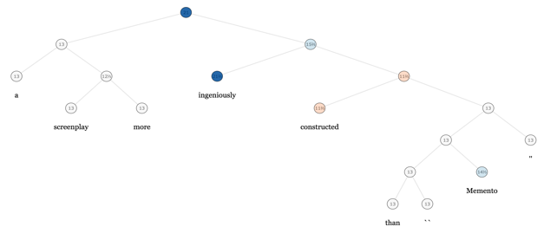
New models have new demands
Models commonly need:
Conditional branching
Loops for recurrence
Recursion over trees
In areas such as probabilistic programming
Models need to reason about other programs (e.g. program generators and interpreters)
Include non-differentiable components like Monte Carlo Tree Search.
# Stanford TreeBank
def model(tree):
if isleaf(tree):
tree.value
else:
model(tree.left) + model(tree.right)

Slide 13
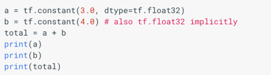
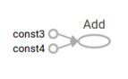
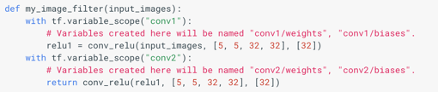
TensorFlow is more like a language and
less like a library
We build a “computational graph” (essentially an AST)
Which may contain control flow (tf.if, tf.while), variable scoping
Cannot reuse existing libraries. Need new libraries for I/O and data processing.
Lazy (Eval) programming in JS
function add(a,b) {
return `${a}+${b}`;
}
x = 1; y = 2
z = add(‘x’, ‘y’) // ‘x+y’
eval(z) // 3
x = 4
eval(z) // 6
Abadi, M., Isard, M., Murray, D., A Computational Model for TensorFlow: An Introduction, 2018.

Slide 14
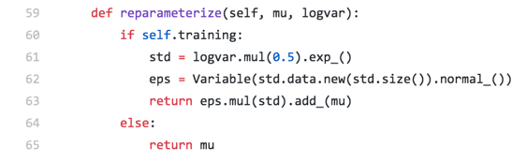
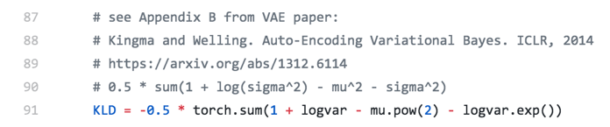
Go beyond executable pseudocode to executable math
VAE in PyTorch
https://github.com/pytorch/examples/blob/master/vae/main.py
In Julia:
Why not just write this?

Slide 15
GPU computing in Julia
Native Array Libraries – CuArrays.jl, GPUArrays.jl, CLArrays.jl
Performance difference between CUDA C++ and CUDAnative.jl implementations of several benchmarks from the Rodinia benchmark suite.
CUDAnative.jl: 1,300 LOC
Besard. T., Foket, C., De Sutter, B., Effective Extensible Programming: Unleashing Julia on GPUs, 2017.

Slide 16
Cassette.jl: Compiler infrastructure for first class AD
Think only about differentiability of algorithms, not of code
Contextual Dispatch: Enable new behaviours for existing Julia programs. For eg., run something written for CPUs on GPUs.
Metadata propagation: Enables trace-local metadata and argument-local metadata to be stored and passed alongside underlying program state without interfering with target program execution
Foundation for upcoming AD capabilities, which are much more general
Julia’s run-compile cycle.
Cassette interacts with the Function Call and Optimization phases.
Revels, J., Cassette Design Document, https://github.com/jrevels/Cassette.jl, https://github.com/JuliaDiff/Capstan.jl, 2018.

Slide 17
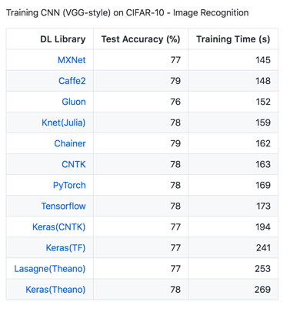
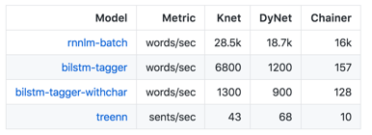
Knet.jl: Mostly Julia. Just Pkg.add(“Knet”)
Dynamic computational graphs generated at runtime for AD of any Julia code.
Write ML models by defining just the forward calculation using the full power and expressivity of Julia.
Use helper functions, loops, conditionals, recursion, closures, tuples and dictionaries, array indexing, concatenation and other high level language features.
Dynet Benchmark Suite
Yuret, D., Beginning Deep Learning with 100 Lines of Julia, NIPS 2016.

Slide 18
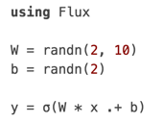
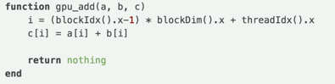
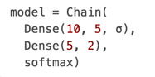
Flux.jl: Pure Julia. Just Pkg.add(“Flux”)
Executable math. Models look just like the description in the paper
Full power and simplicity of the Julia language (including control flow, multiple dispatch and macros).
Lightweight and Hackable
Only a few thousand lines of Julia all the way down
Graph-aware with smart optimizations for speed and memory
No need to Define-before-Run like other frameworks
Innes, M., Flux: Fast, flexible machine learning with Julia (Under preparation), https://github.com/FluxML/Flux.jl, 2018.
Innes, M., Besard, T., Danisch, D., CuArrays: JIT-compiled GPU array support in Julia, https://github.com/JuliaGPU/CuArrays.jl, 2018.

